Slide 1
Flowers for Algernon
A Utilitarian Perspective

Slide 2

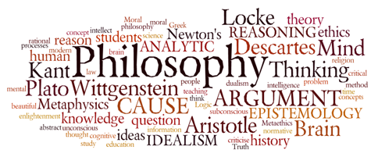
Check for Understanding
Learning Goal:
Exceeding Learning Goal:
Philosophers will examine how Mill differentiates levels of happiness and how these levels impact ethical behavior.
Philosophers connect the different examples of moral reasoning to current times and aspects of their lives.

Slide 3
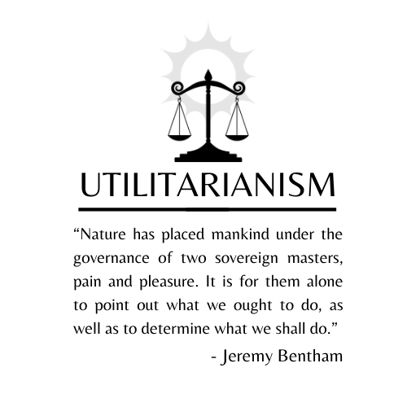
The Principle of Utility
“Actions are right in proportion as they tend to promote happiness, wrong as they tend to promote the reverse of happiness.”
Happiness = pleasure & absence of pain
Unhappiness = pain & absence of pleasure
Slogan: “Greatest Good for the Greatest Number of People”

Slide 4
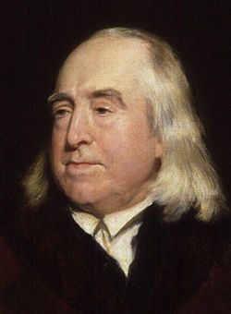
Bentham stated, “The quantity of pleasure being equal, push-pin is as good as poetry.”
(Push-Pin was a child’s game)
Is this true?
What is considered “Good”? Who decides?

Slide 5
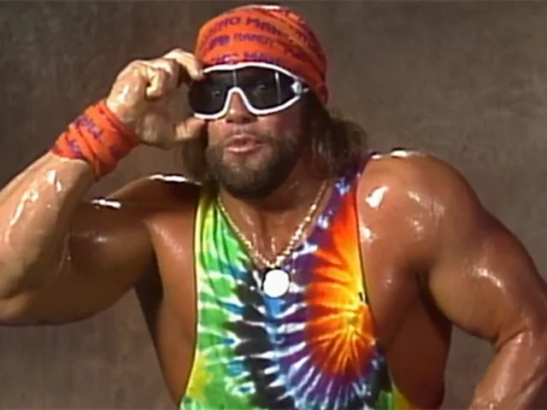
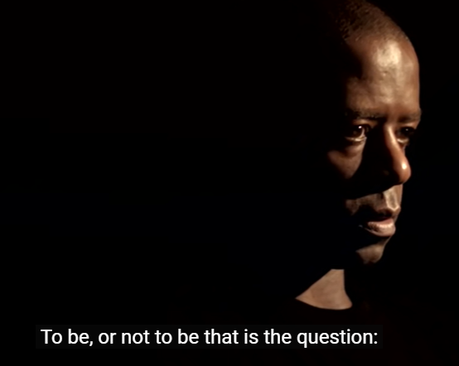


How can we know which pleasures are qualitatively higher?
Mill proposes a simple test:
“Of two pleasures, if there be one to which all or almost all who have experience of both give a decided preference, irrespective of any feeling of moral obligation to prefer it, that is the more desirable pleasure.”
https://www.youtube.com/watch?v=8C4lK41SX-Q https://www.youtube.com/watch?v=muLAzfQDS3M https://www.youtube.com/watch?v=E2dmfnSarDI
Which of these did you find most pleasurable?
Which of these do you think is the highest, or worthiest?
Notes:
Katelyn Ohashi - 10.0 Floor (1-12-19) - YouTube

Slide 6


The Test of Higher Pleasures
Who decides which pleasures are higher? Can this be done objectively?
  Consider determining which pizza shop has “better” pizza…how would we establish this?
  How would we count the opinion of those who have not tasted both?
    Are certain people in a better position to judge?

Slide 7
From Justice…
Mill concedes that “occasionally, under the influence of temptation,” even the best of us postpone higher pleasures to lower ones. Everyone gives in to the impulse to be a couch potato once in a while.
But this does not mean we don’t know the difference between Rembrandt and reruns.
Mill makes this point in a memorable passage: “It is better to be a human being dissatisfied than a pig satisfied; better
to be Socrates dissatisfied than a fool satisfied. And if the fool, or the pig, are of a different opinion, it is because they only know their own side of the question.”
Notes:
By Michael Sandel

Slide 8
Ethics: What Is the Right Thing to Do?
Mill: The Higher Pleasures
Do you agree with Mill’s belief that is “better to be Socrates dissatisfied than a fool satisfied?”
Mill wrote, “A being of higher faculties requires more to make [them] happy, is capable probably of more acute suffering… than one of an inferior type; but in spite of these liabilities, he can never really wish to sink into what he feels to be a lower grade existence.” Agree or disagree?

Slide 9
Check for Understanding
Learning Goal:
Exceeding Learning Goal:
Philosophers will identify moral dilemmas and apply utilitarian principles to the characters and events in Flowers for Algernon.
Philosophers connect the different examples of moral reasoning to current times and aspects of their lives.

Slide 10

Ethics: What Is the Right Thing to Do?
Flowers for Algernon

Slide 11
Ethics: What Is the Right Thing to Do?
Flowers for Algernon
Mid-Point Reading Check
With your partner, go to the following dates and determine the changes that are happening to Charlie:
April 6
April 9
April 10
April 14
April 22

Slide 12
Flowers for Algernon
Post Reading Check
With your partner, please discuss and complete the following questions:
John Stuart Mill believed that we could prioritize intellectual enjoyments over more simple ones. He famously said, “It is better to be Socrates dissatisfied, than a fool satisfied.” How can you connect this quote to Charlie Gordon?
What does Charlie learn about his “friends,” Joe and Frank? In this instance, would it be better to be a “fool satisfied” and not know what Joe and Frank really think of him? Explain.
How does Charlie feel when he starts to become more intelligent than the doctors and Miss Kinnian? Does he seem like he has become “Socrates dissatisfied”? Explain.
Does it seem like Charlie understood the procedure he was signing up for? What ethical issues does the story raise and how might we approach these issues?
Do you think that people are able to live happier and more fulfilling lives when they are more intelligent? Given your answer, what changes, if any, might you want make to the current education system?
How was Charile’s identity affected by the experiment?
Was Charlie’s identity defined more by his own thoughts about himself or how others perceived him? Explain.

